Slide 1
Risk Exposure to Social Networks in Enterprises
Marco Casassa Mont
Cloud & Security Lab
HP Labs, Bristol, UK
CCCS Conference 2011
Newcastle, 15 March 2011

Slide 2
Outline
Adoption of Social Networks in Enterprises
Analysis of Involved Threats and Risks
Decision Support for Risk Assessment
Conclusions

Slide 3
Outline
Adoption of Social Networks in Enterprises
Analysis of Involved Threats and Risks
Decision Support for Risk Assessment
Conclusions

Slide 4

Adoption of Social Networks
Widespread usage of Social Networks by People, World Wide:
“Nearly one in five Internet users is tweeting on Twitter or using another service to share personal and business updates, or to see updates about others (Pew Internet & American Life Project, 2009)”

Slide 5
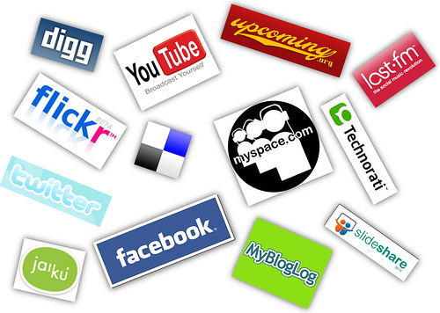
Usage of Social Networks in Enterprises
Increasing Usage of Social Networks by Employees:
- Within the Organisation
- At Home (potentially with Work Equipment…)
- When Travelling …
Blurring the Boundaries between
Work and Private Life:
- Consumerization
- Reflected by the Information shared
in Social Networks …

Slide 6
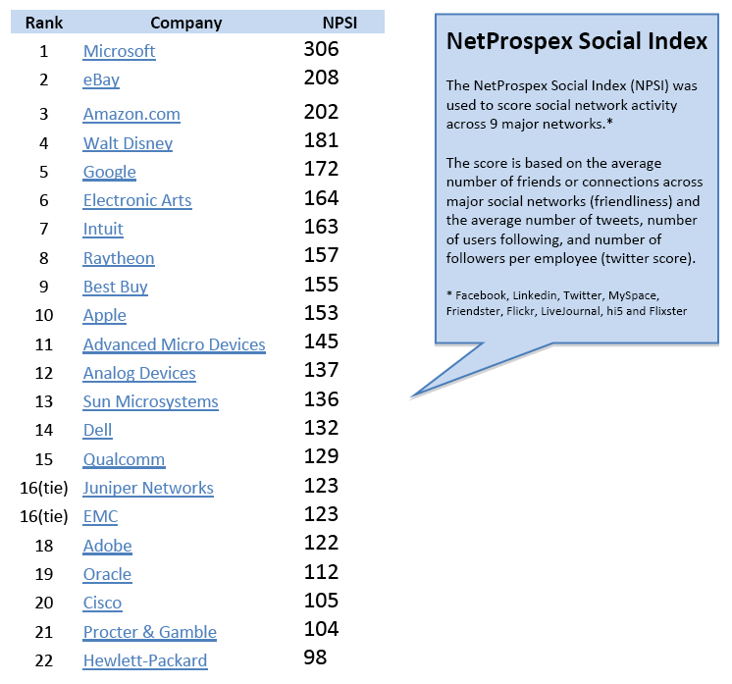
Statistics - Employees’ Adoption of Social Networks
Ranking of US Organisations,
Based on their Employees’ usage of Social Networks
(100K contact records)
Source: NetProspex Social Report,
May 2010 (100K contacts)

Slide 7
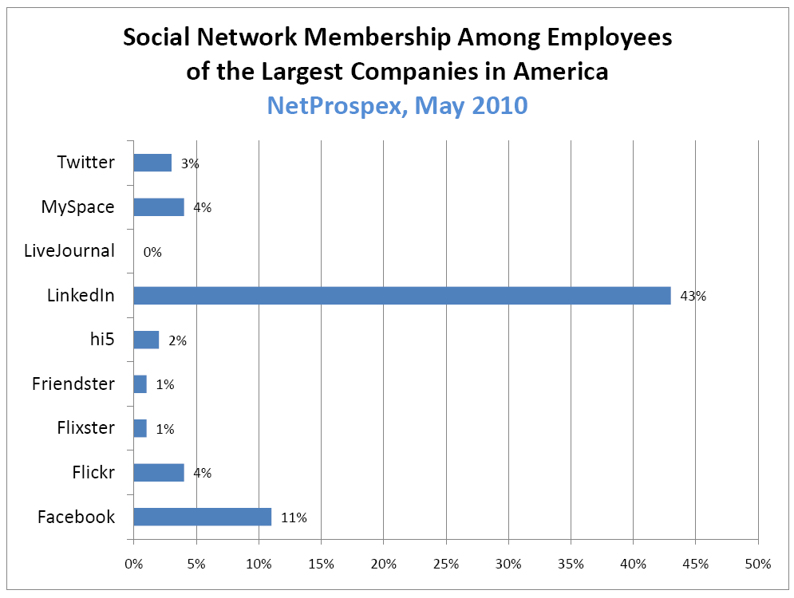
Statistics - Employees’ Adoption of Social Networks
Social Network Membership in US Largest Companies
Source: NetProspex Social Report,
May 2010 (100K contacts)

Slide 8
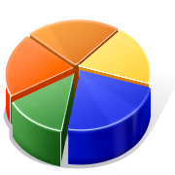
Statistics - Employees’ Approach to Social Networks
Deloitte Ethics & Workplace Survey, 2009:
  1/3rd of employed respondents say they never consider what their boss would think before posting materials online.
  61% of employees say that even if employers are monitoring their social networking profiles or activities, they won’t change what they are doing online
  54% of employees say a company policy won’t change how they behave online

Slide 9
Statistics - Employees’ Approach to Social Networks
- 1st Annual Risk Index of Social Networks of SMBs Study - Panda Security Report (315 SMBs, 1000 employees):
  77% employees Use Social Networks during Work Hours
  33% infected by Malware distributed by these communities
  …

Slide 10

Advantages for Enterprises
Sharing Knowledge
Collaborations
Potential Productivity Increase – in specific Work Areas …
Utilization of Social Networks for Enterprise Functions:
  Sharing Corporate Messages
  Looking for Job Candidates
  …
But there are Issues too …

Slide 11
Outline
Adoption of Social Networks in Enterprises
Analysis of Involved Threats and Risks
Decision Support for Risk Assessment
Conclusions

Slide 12
Threat Areas for Organisations
Data Leakage
Reputational Damage
Malware & Virus Attacks
De-Perimeterisation of Organisation’s
Information Boundaries
Compliance & Legal Implications
Loss of Productivity
…

Slide 13
Attack Surface & Attack Vectors
Attack Surface
Personal and Confidential Information, disclosed to Social Networks
Compromised Systems and IT Infrastructure (e.g. due to Malware downloaded from Social Networks)
Employees …
Attack Vectors
Employees & Insiders
External Attackers (Hackers, Competitors, Criminals, etc.)
  Data aggregation & correlation (using various Automation Tools)
  Social Attacks (bogus accounts, etc.)
  …

Slide 14
Key Threat: Malware & Malicious Code
Some Statistics
WebSense 2010 Threat Report:
  40% of all Facebook status updates have links: 10% of those links are either spam or malicious
  65% of Top 100 (and 95% of Top 20) most popular Websites categorized as Social Networking or Search …

Slide 15
Key Threat: Data Leakage
Which Personal and Business (Confidential) Information is actually stored out there?
Who is Looking at it? What can they Learn?
Many ways to Learn about Organisations’ Tactics and Strategies, based on Information posted by Employees:
  Correlations
  Data Mining
  Deductions & Intuitions
  Tools automating the heavy and mechanical data mashing activities …

Slide 16
Data Leakage: Types of “Attacks” on Social Networks [1/2]
Vertical Attacks
Attacks focusing on the profile of one of more individuals within a Social Network
Profiling of Employees
Aggregate Profiles & Data provided by different Employees
Correlation of Information Provided by Employees In the same Company
  e.g. A few Employees of Company X and Area Y suddenly looking for new Job Opportunities …
Social Network X
Attackers’
Data Aggregation
& Correlation
+
+
Employees’ Profiles &
Posted Data

Slide 17
Data Leakage: Types of “Attacks” on Social Networks [2/2]
Horizontal Attacks
Attacks focusing on the Profile & Data of one of more individuals with presence in multiple Social Networks
Aggregation and Correlation of Profiles & Data across various Social Networks
Social Network X
Social Network Y
Social Network Z
Employee’s
Profiles & Posted Data
+
+
Attackers’
Data Aggregation
& Correlation

Slide 18
Are Organisations Prepared?
- In general Organisations are not Prepared to Address the Involved Risks
Typical Extreme Approaches:
  Over-Reaction (block accesses …) vs. Under-Reaction (ignore the problem …)
Many Security Professionals still believe that Social Media is a Personal Platform …
Frost & Sullivan’s Global Information Security Workforce Study (GIWS – 10000 Information Security Professionals):
  Organisations allowing employees to access Facebook (51%) or Linkedin (63%) at work
  28% of their organisations have no restrictions on the usage of social media (31% for EMEA region…)

Slide 19
Outline
Adoption of Social Networks in Enterprises
Analysis of Involved Threats and Risks
Decision Support for Risk Assessment
Conclusions

Slide 20
How to Help Enterprises to Address Risks?
Which Strategy should Organisations Follow?
    It depends on the Context, Organisational Culture & Environment, Employees, …
Which Investments Should they Make?
    Education, Enforcement (e.g. Blocking Access), Monitoring,
    Hybrid Investments … ?
Limitation of Risk Assessment based on ISO 2700x:
    ISO 2700x Provides a General Framework
    Coarse Grained …
    Still need to be contextualised to the specific Organisational Reality …

Slide 21
Need to Provide Strategic Decision Support
Target Key Decision Makers (CIOs, CISOs, Risk Officers, etc.)
Illustrate the “Risk Exposure” due to the Adoption of Social Networks - based on the actual Employees’ Attitude, Processes and Controls (grounding to the Organisation’s Reality)
Illustrate, in advance (“What-if” analysis) the implications of making specific Decisions and/or Investments
Explore suitable “trade-offs” for Strategic Aspects of relevance (Economics): Security Risks, Productivity, Compliance, Costs, …

Slide 22

Problems with Security Investments
Security Investments affect multiple outcomes: budget, confidentiality, integrity, availability, …
In most situations these outcomes can only be predicted with high degrees of uncertainty
Often the outcomes are inter-related (trade-off) and the link to investments is poorly understood
Classical business justification/due diligence (Return on Security Investment, cost benefit analysis) encourages these points to be glossed over

Slide 23
R&D: Potential Approaches to Move Forward
1. Security Analytics
2. Situational Awareness

Slide 24

Security Analytics
Providing Strategic Decision Support
R&D Work carried out at HP Labs, Bristol, UK
(transferring to HP Information Security – HP Business Group)
Collaboration with UK “Trust Economics” Government-sponsored Project:
  Economics, Maths Foundations, Cognitive Science & Human Factors
  UCL, Newcastle University, Bath University, (Merrill Lynch in transition to National Grid), HP Labs

Slide 25
Security Analytics
Providing Strategic Decision Support to Decision Makers (e.g. CIOs, CISOs, etc.)
Using Modelling and Simulation to Represent Process, IT Systems, Interactions, Human Behaviours and their Impact on Aspects of Relevance: Security Risks, Productivity, Costs, …
Carry out “What-If” Analysis and Make Predictions, based on Alternative Investments, Threat Environments, etc.

Slide 26

Security Analytics:
Integrating Scientific Knowledge
Security/Systems
Domain knowledge
Economic Theory
(utility, trade offs,
externalities, information asymmetry, incentives)
Applied
Mathematics
(probability theory,
queuing theory,
process algebra,
model checking)
CISO / CIO /
Business
Empirical Studies
(Grounded theory,
discourse analysis,
cognitive science)
Experiment and Prediction
(Discrete event modelling
and simulation)
Business Knowledge
Notes:
Today most security teams have good knowledge about IT and are working hard to align this with business knowledge.
We are looking to take this further to make business aligned security decisions based on simulation and prediction. To support this we are using appropriate economic and mathematical tools
15 March 2011
HP Confidential
26

Slide 27
Security Analytics Methodology
Problem
Definition
Empirical
Data Gathering
Modelling
Validation
Outcome
Analysis
Simulation

Slide 28

Applying Security Analytics
Risk Assessment in Social Networks
Identify Suitable Metrics to Convey “Risk Exposure”:
  Amount of Leaked Data
  Amount of Data Prevented from Leaking
  Exposure of Company-related data to Social Networks …
  Type of data …
Create Grounded Models of:
  Employees behaviours
  Enterprise Policies, Processes and Controls
  Cause-effect relationships at the base of Data Leakage …
  Effectiveness of Current Controls
  Threat Environments (e.g. Attackers, etc.) and Types of Attacks …
Simulations – What-if Analysis …

Slide 29
Security Analytics (Template) Model
Event:
Employee’s
Access to SN
Event:
Attack
Access
Location?
Outside
Work
Process:
Identification of
Targeted SNx
At Work
Selection
of
Attack Activity
Process:
Choice of
Suitable SNx
Process:
Choice of
Suitable SNx
Successful
Attack?
Process:
Selection of SN
Activity
(Share, Read,
Delete …)
Data
Deletion
In SNx?
SNx Status:
Disclosed Data
Type of Data
Access
Attempt Blocked or
Discouraged By
Enterprise
Controls?
YES
SNx Status:
Disclosed Data
Type of Data
YES
NO
SNx Status:
Disclosed Data
Type of Data
OUTPUT MEASURES
- # of confidential
information retrieved
Types of data
Types of attacks
NO
Data
Disclosure
To SNx?
YES
Data
Leakage?
YES
OUTPUT MEASURES
- # Confidential Data Exposed
- # Types of Data

Slide 30
Modelling Aspects
Types of Organisational Controls:
  Enforcement Controls
  Educations
  Monitoring and Punishment
Level of Investment/Effectiveness of Controls:
  0: none, 1: Low, 2: Medium, 3: High
Types of Data and Potential Value
Involved Costs
  Function(Enforcement[Level], Education[Level], Monitoring&Punishment[Level])
Attackers: Motivations and Skills
Overall Risk Exposure:
  Function (attacker_skill_level, attacker_motivation_level) * Information_Disclosed(value)

Slide 31
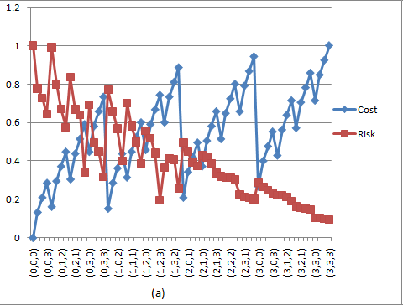
Simulations & What-If Analysis
Experimental Results - Cost vs. Risk Trade-offs:
Investments = (Control, Education, Monitoring)

Slide 32
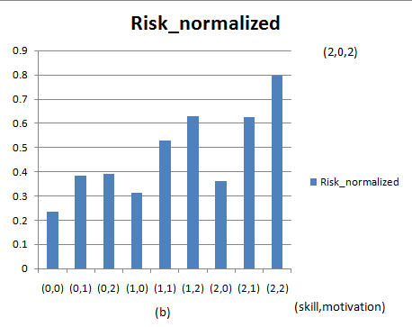
Experimental Results
Risk Exposure based on Attackers’ Factors
Risk Exposure
Attacker’s Profile = (Skill, Motivation)

Slide 33
Role of “Situational Awareness”
“Trust but Control”
Monitoring strategic Organisational Assets, Communications and Information Flows
Leveraging emerging Security Information and Event Management Solutions/Frameworks (SIEM)
Get early warning about Trends and Threats
Obtain “grounded data” to support Security Analytics activities …

Slide 34
Importance of Understanding the
Threat Environment
Nature of Threats
Motivations of Attackers and Related Ecosystem
How to Disrupt the Threat Environment
  Investing in Additional Controls
  Disrupting the Ecosystem of the Attackers
  …
Work in Progress …

Slide 35
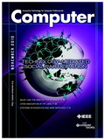
More Information …
IEEE Computer Magazine
Using Modeling and Simulation to Evaluate Enterprises'
Risk Exposure to Social Networks
January 2011 (vol. 44 no. 1)
pp. – 66-73
Anna Squicciarini, Pennsylvania State University
Sathya Dev Rajasekaran, Pennsylvania State University
Marco Casassa Mont, HP Labs
HP Information Security - http://h10131.www1.hp.com/uk/en/information-security/security-innovation/
Trust Economics - http://www.trust-economics.org/

Slide 36
Outline
Adoption of Social Networks in Enterprises
Analysis of Involved Threats and Risks
Decision Support for Risk Assessment
Conclusions

Slide 37
Conclusions
Trend: Increasing Adoptions of Social Networks by Employees
Potential Exposure to High Risks. Organisations are Unprepared on How to React …
Risk Assessment Methodologies like ISO 2700x shows their Limits. Need for Decision Support based on Scientific Methods …
Security Analytics (based on Modelling and Simulations) can play a key Role in this Space
Importance of Situational Awareness and Understanding of Threat Environment
Work in Progress …

Slide 38
Q&A
Marco Casassa Mont
HP Labs, Bristol, UK marco.casassa-mont@hp.com

